Slide 1
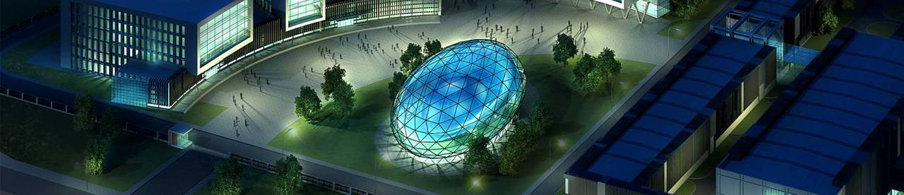



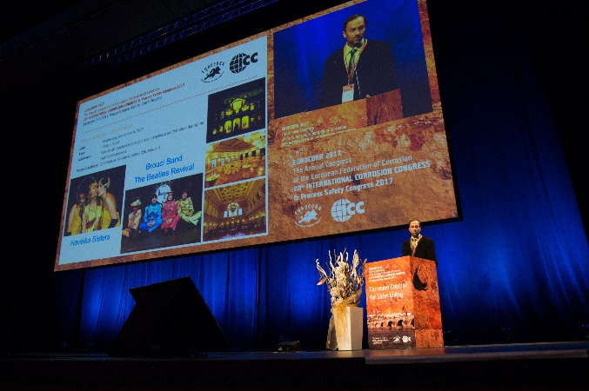



European Corrosion Congress 2017, 20th International Corrosion Congress & Process Safety Congress
Prague, Czech Republic on September 3–7, 2017

Slide 2

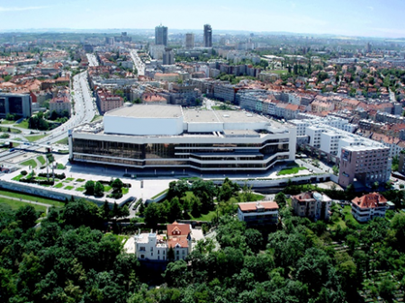
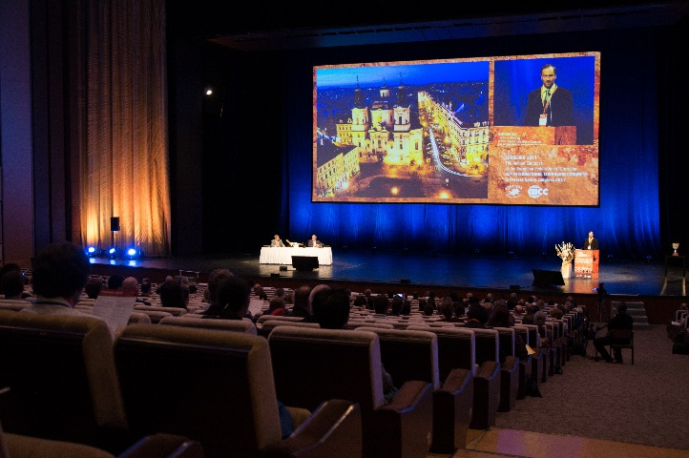
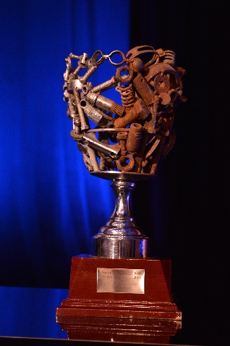
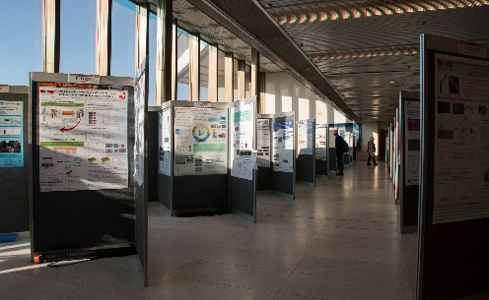
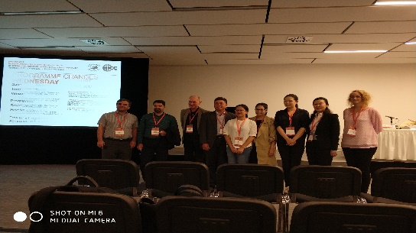
1
ICC-introduction
ICC(International Corrosion Congress)-introduction
Prague Congress Centre
Corrosion science and engineering and material protection:
1500 delegates; 20 pointed keynote lectures; 800 oral presentations; 15 parallel sessions

Slide 3

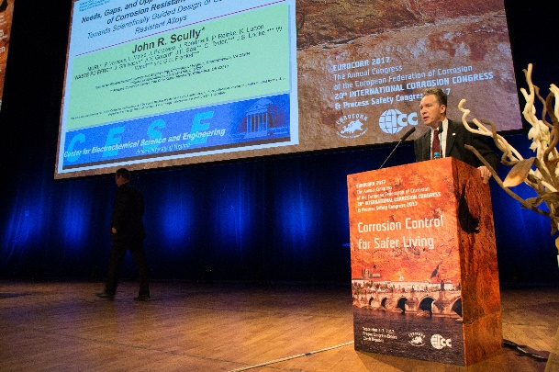
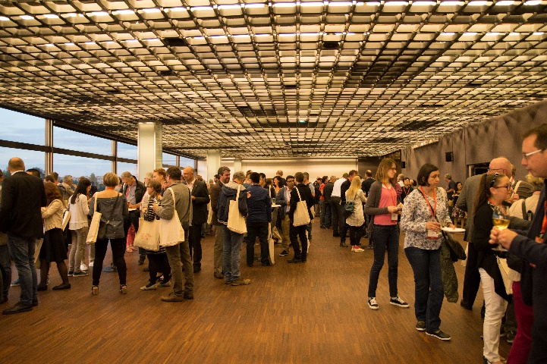
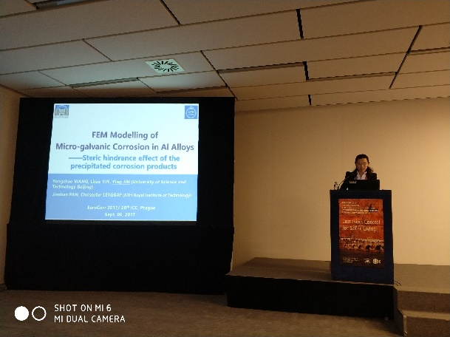
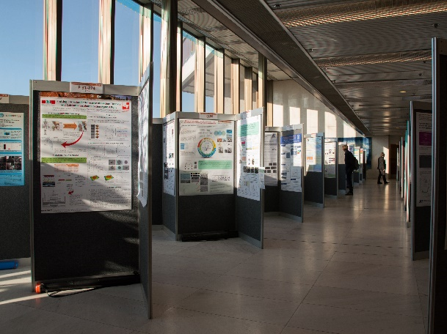

1
ICC-introduction
ICC(International Corrosion Congress)-schedule
Opening ceremony
Plenary lecture
Welcome reception
Oral presentations
Poster party
Gala dinner
Plenary lecture>Oral presentations>Social program

Slide 4
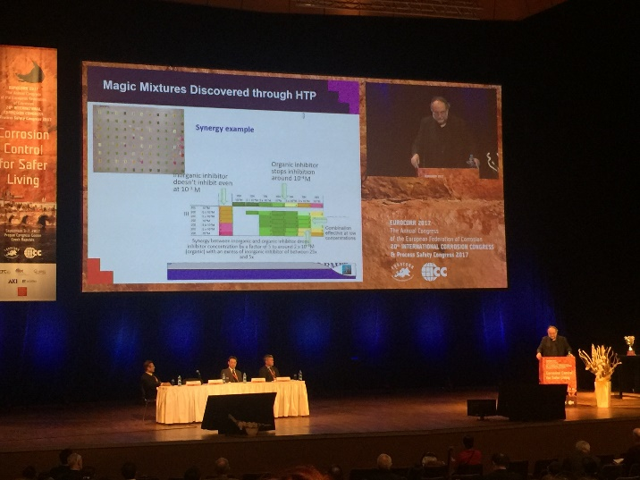
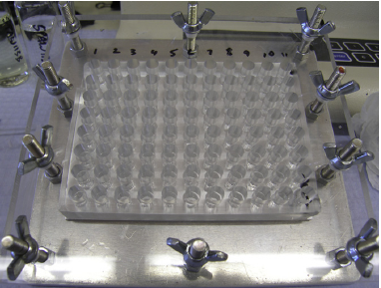
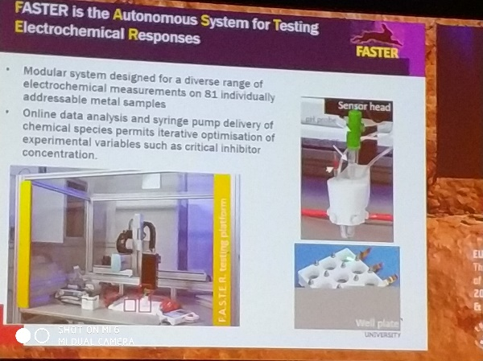
2
Plenary lecture-Ivan Cole
Virtual Design, Robotic Discovery and High throughput Studies of Atmospheric and Aerospace Corrosion
Modular system designed for a diverse range of electrochemical measurements on 81 individually addressable metal samples
Online data analysis and syringe pump delivery of chemical species permits iterative optimization of experimental variables such as critical inhibitor concentration
Experimental science: planning and execution of experiments to confirm/ reject scientific laws/models
Computer-enabled science: modeling & simulation of complex or non-observable phenomena
Big data-driven science: data mining & exploration

Slide 5
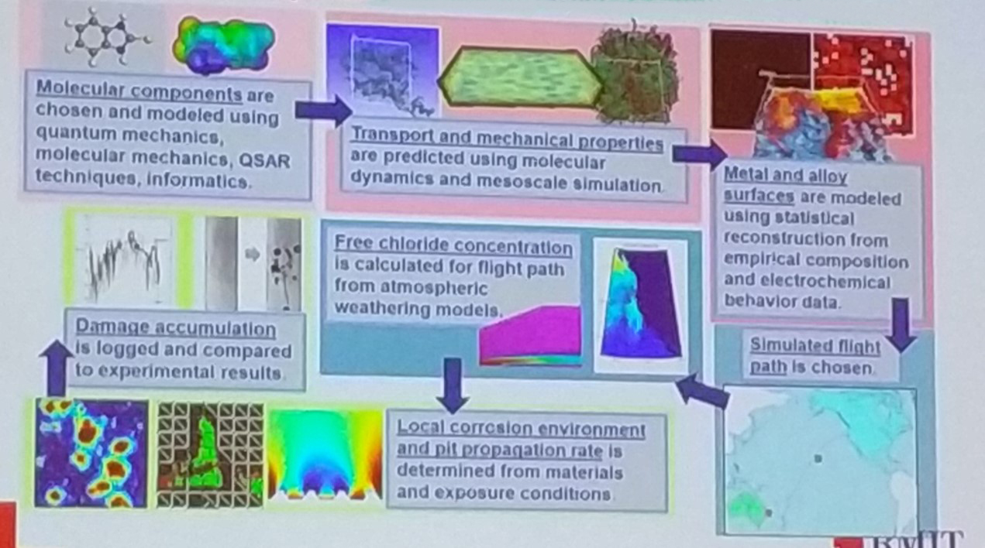
2
Plenary lecture-Ivan Cole
Atoms-to-Atmospheres modeling of aerospace coatings:
Linking material systems, environments and performance/lifetimes

Slide 6
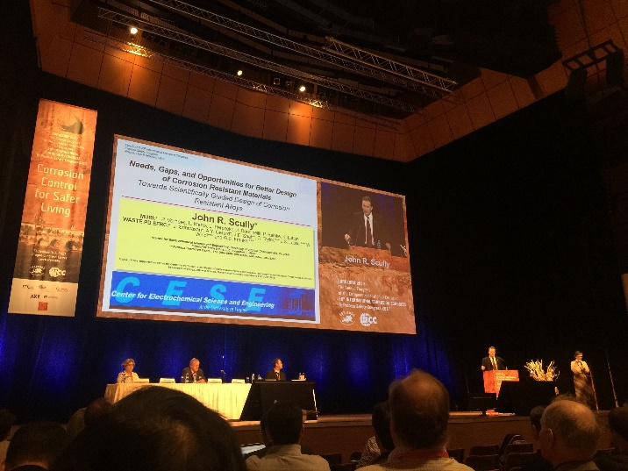
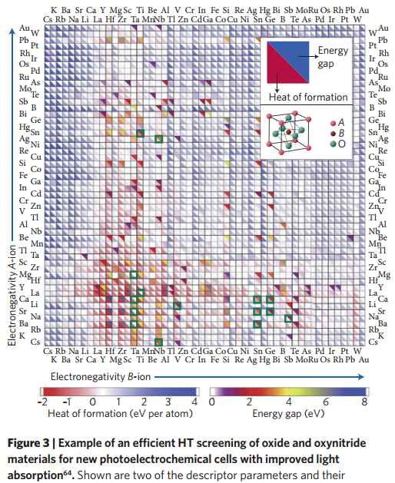
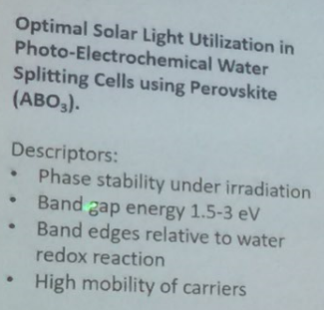
2
Plenary lecture-Scully
Needs, Gaps, and Opportunities for Better Design of
Corrosion Resistant Materials
Example of an efficient HT screening of oxide and oxynitride materials for new photo electrochemical cells with improved light absorption
The high-throughput highway to computational materials design

Slide 7
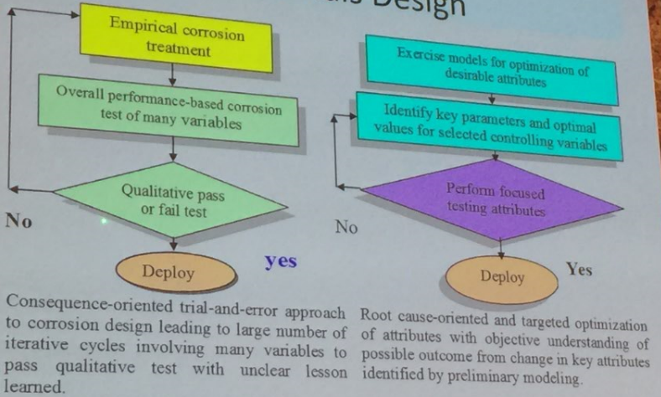
2
Plenary lecture-Scully
Challenges for Corrosion Informed Materials Design

Slide 8
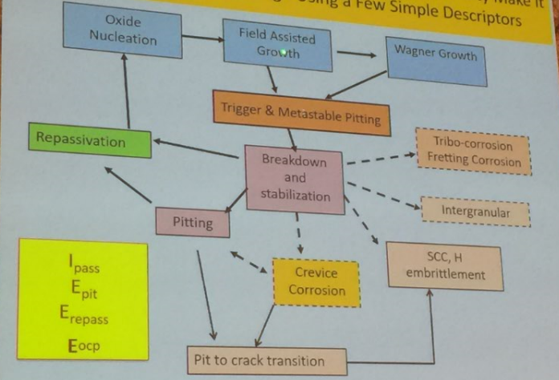
2
Plenary lecture-Scully
Complex stages accounting for local corrosion susceptibility make it difficult to guide alloy design using a few simple descriptors

Slide 9
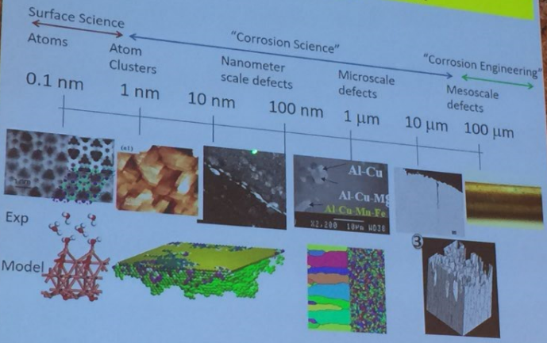
2
Plenary lecture-Scully
A multi-scale problem

Slide 10
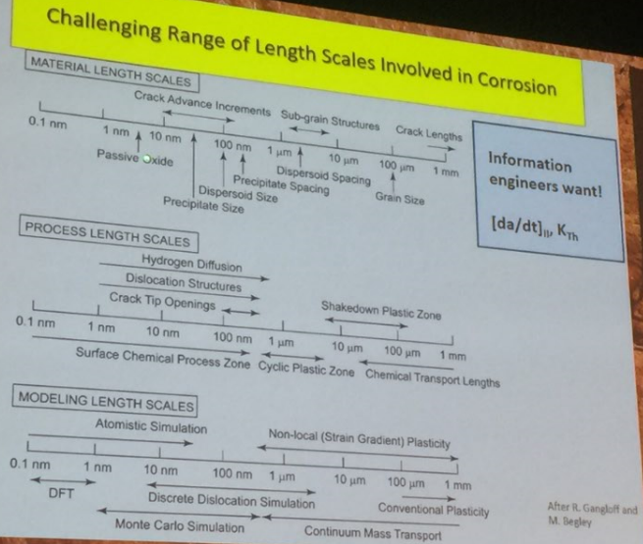
2
Plenary lecture-Scully
Challenging range of length scales involved in corrosion

Slide 11
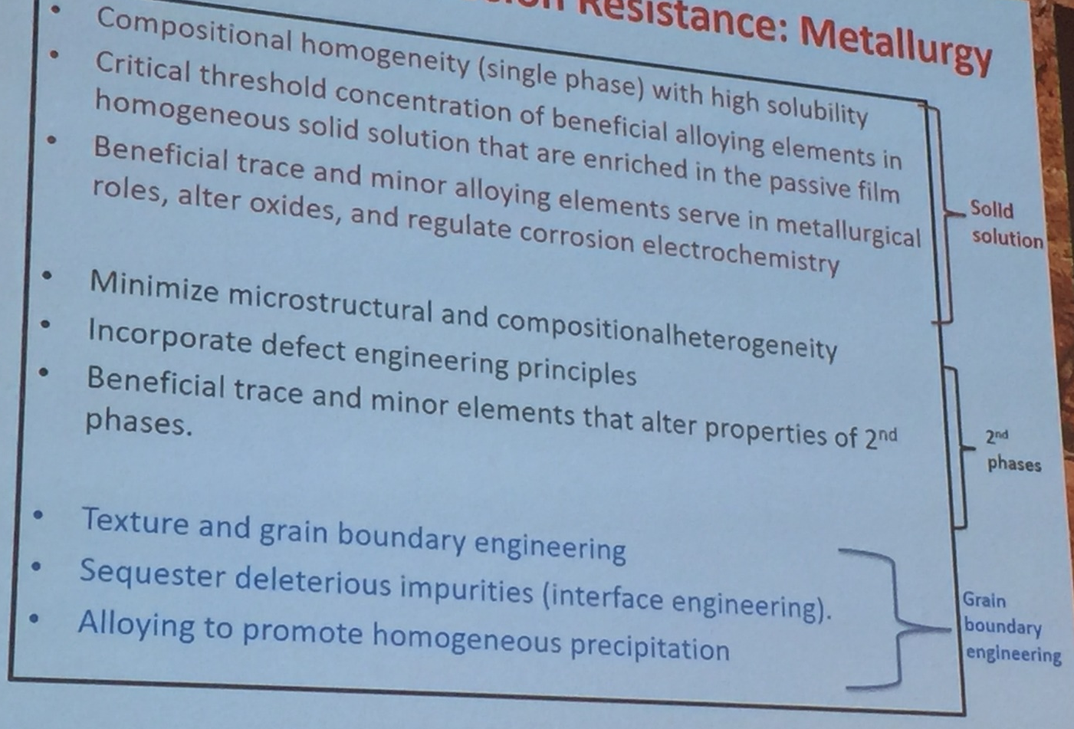
2
Plenary lecture-Scully
Alloy design for corrosion resistance: metallurgy

Slide 12
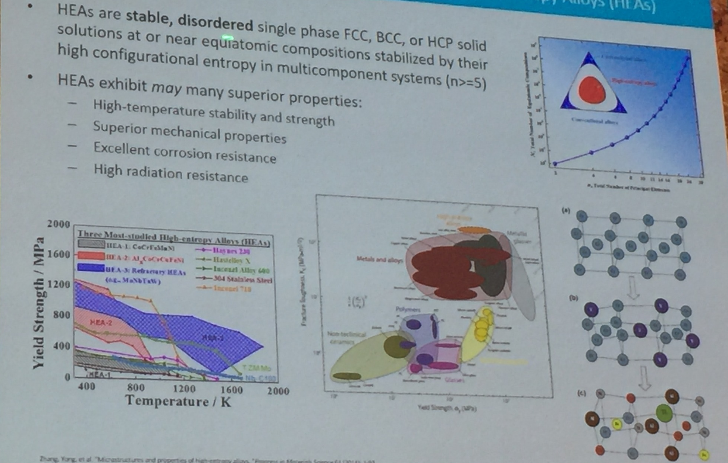
2
Plenary lecture-Scully
The future frontier of ultra corrosion resistance materials is compositional complex alloys: High Entropy Alloys

Slide 13
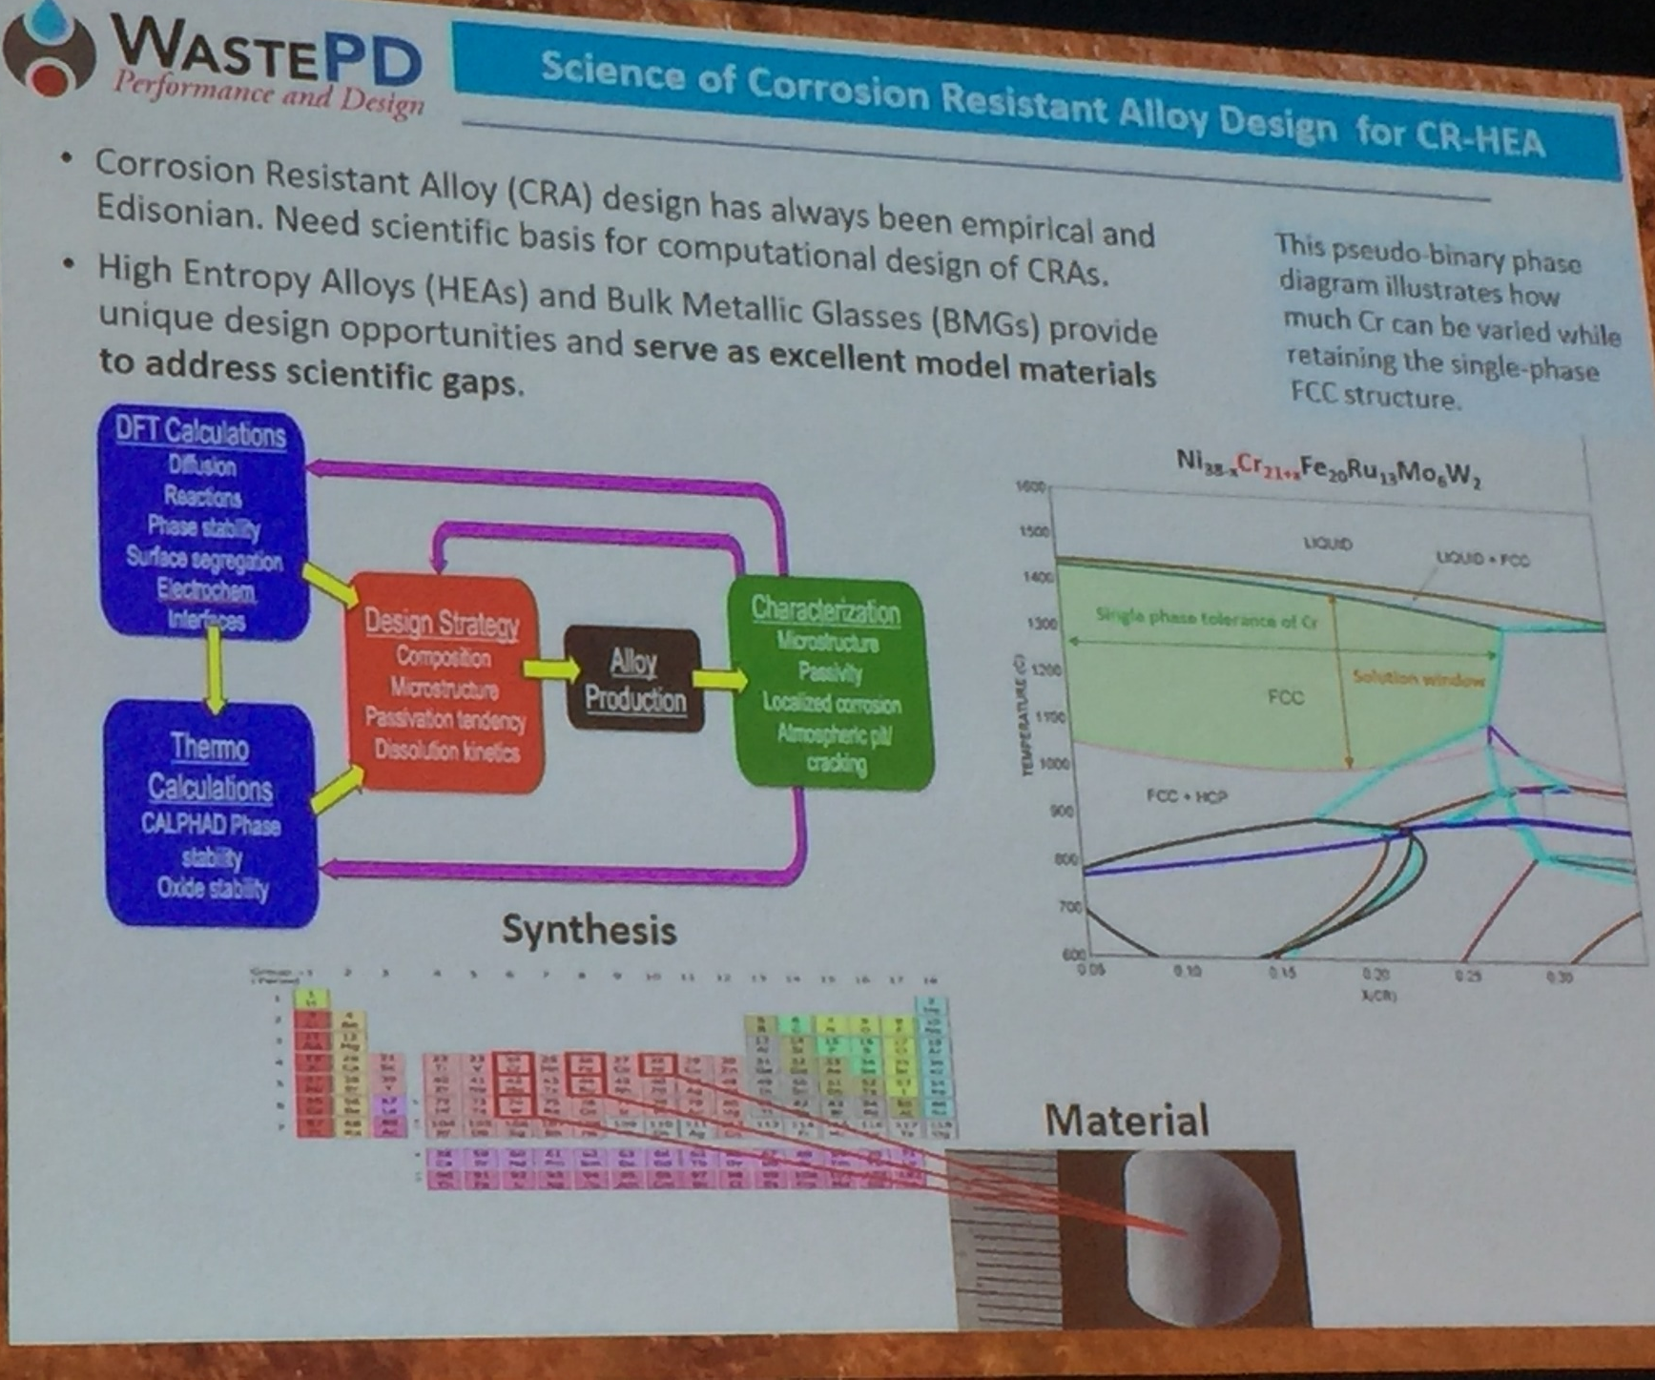
2
Plenary lecture-Scully

Slide 14
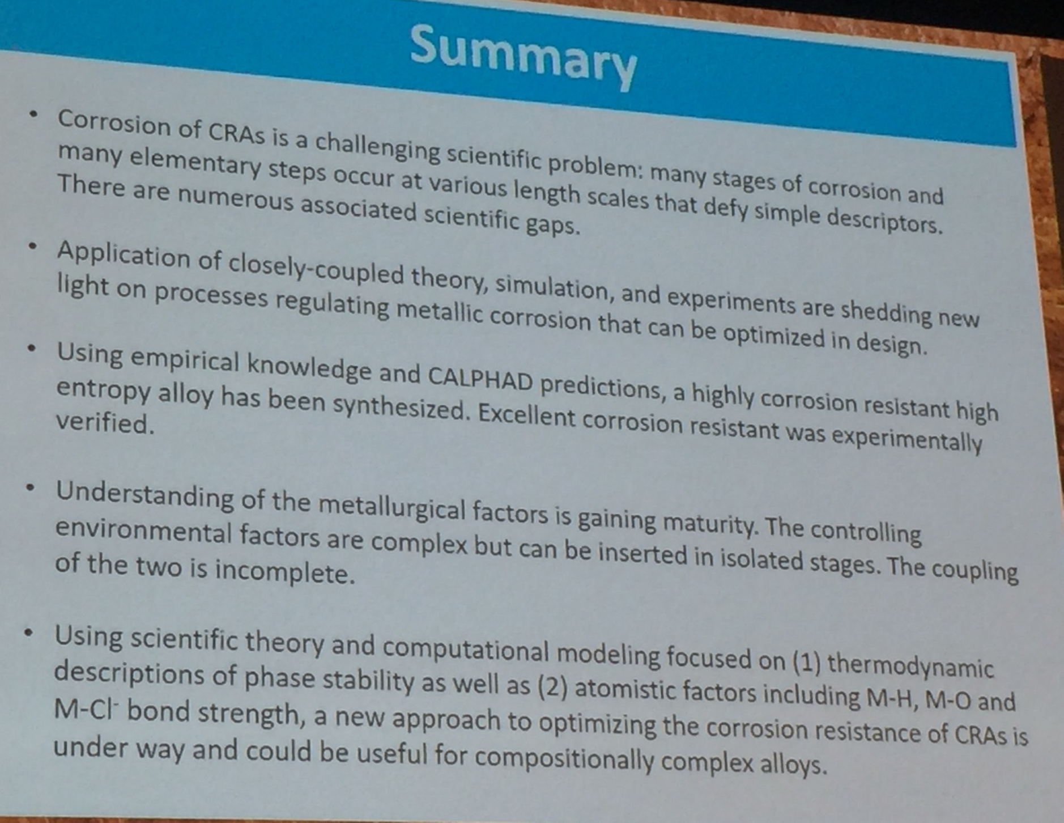
2
Plenary lecture-Scully

Slide 15
2
Plenary lecture-summary
Key words:
High throughput, inhibitor screen, photo electrochemical;
Material design: computational modeling
Experiments>big data> data mining & exploration
Both of them have similar research ideas and methods
The research system is complicated, high-workload and
high-grade, precision and advanced(strong team)
Our group research is similar with them: advanced in ideas and methods but not overall and systematic
Perfect experimental design
Enhance own knowledge structure and the level, establish our
own thought system

Slide 16
3
Oral presentations
Main topics will include the advances:
Corrosion prevention, Corrosion monitoring, Corrosion resistant materials, Surface treatment and coatings, Inspection and non-destructive testing, Electrochemical methods, Analytical techniques and microscopy, Corrosion inhibitor…
Techniques:
In situ synchrotron X-ray diffraction
SKPFM(Histogram and PSD analysis )
HS-AFM
SECM
LEIS…

Slide 17

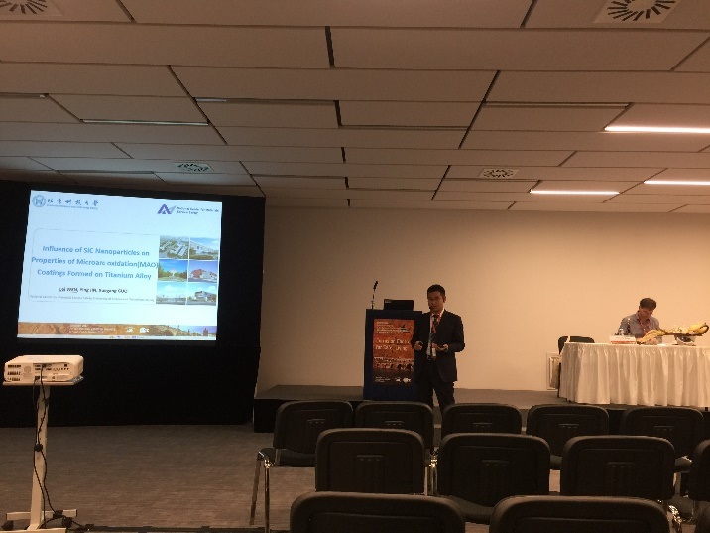
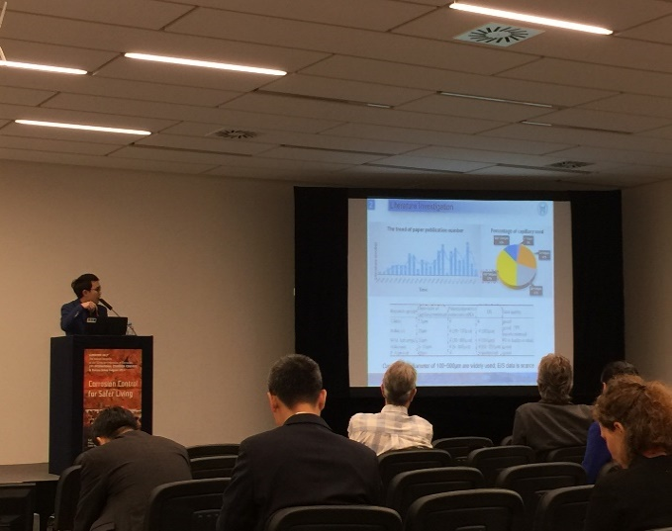

3
Oral presentations
FEM Modeling of Micro-galvanic Corrosion in Al Alloys
Influence of SiC nanoparticles on the properties of MAO coatings formed on titanium alloy
A novel method for testing local electrochemical properties of each single phase in the matrix
Oral English: speed, clearly, fluently> more practice
Prepare of PPT: logical, artistic, professional, time-efficient
Confidence : overcome nervousness
Question : improvise
Challenge for us: language

Slide 18
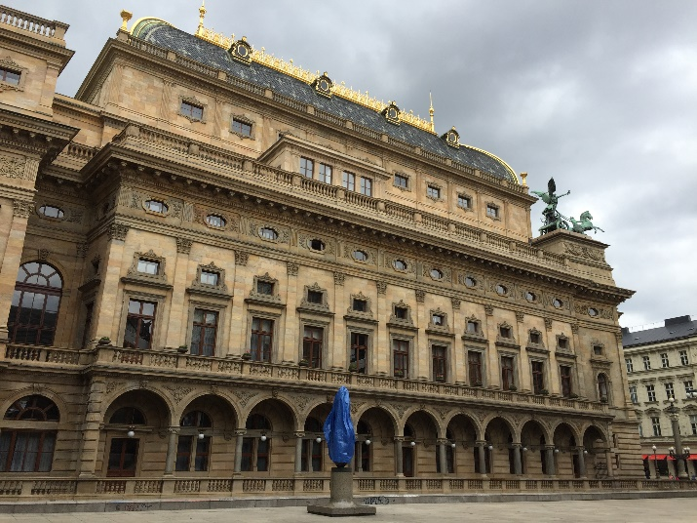
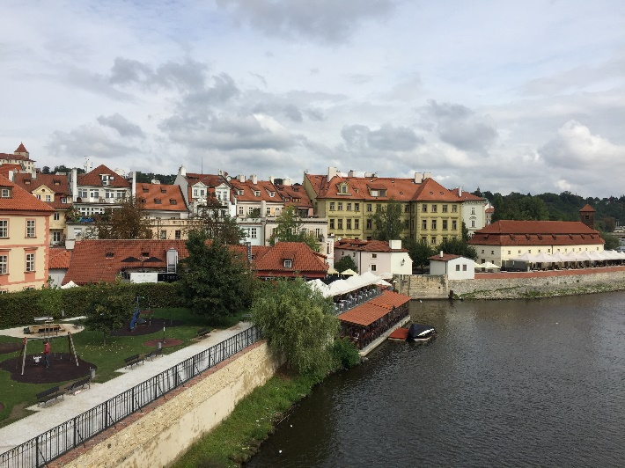
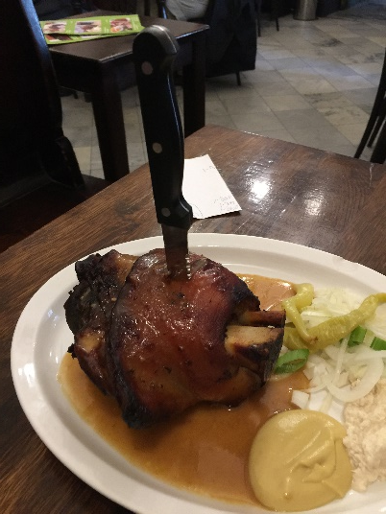
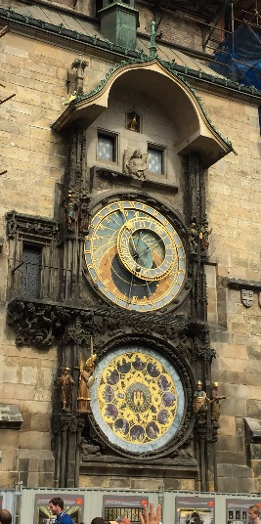
4
Summary
Enhance own knowledge structure and the level, establish our
own thought system
Perfect experimental design and complete it in good quality
Perfect the skill to write a PPT
Practice oral English for communication
Be confidence to face challenge

Slide 19


National Center for Materials Service Safety
University of Science & Technology Beijing
Thanks for your attention !

